Slide 1
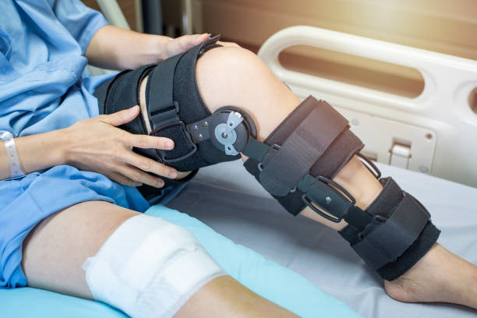


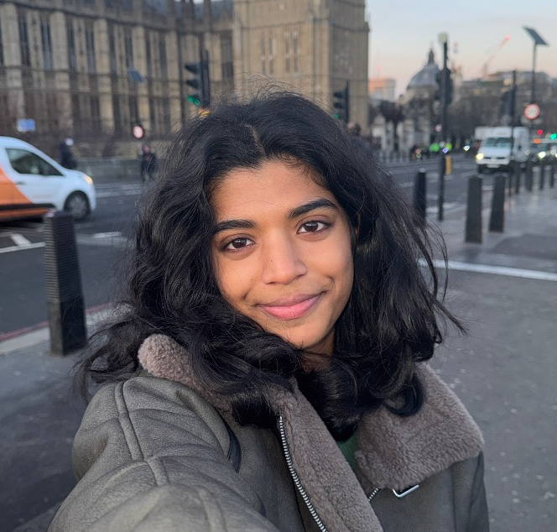

A New Era of Mobility Starts Here.
Global Health Innovation Grand Challenge 2025
Neurostride
Clara
Chavonz
Lavantika
Aasish

Slide 2
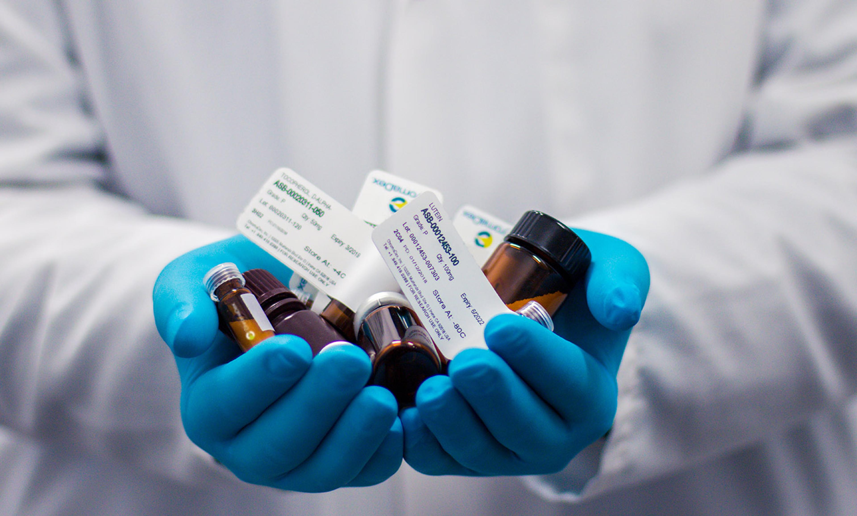
Problem
Clara

Slide 3

For millions of osteoarthritis (OA) patients, every step is a struggle.
The fittest person you know
Rae

Slide 4
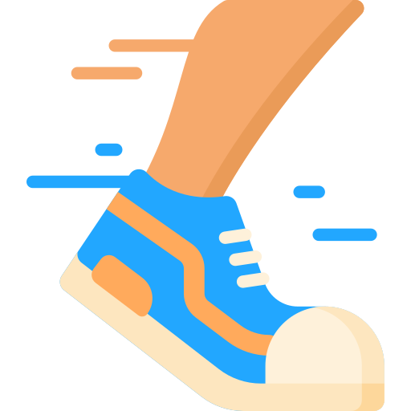


For millions of osteoarthritis (OA) patients, every step is a struggle.
Rae

Slide 5

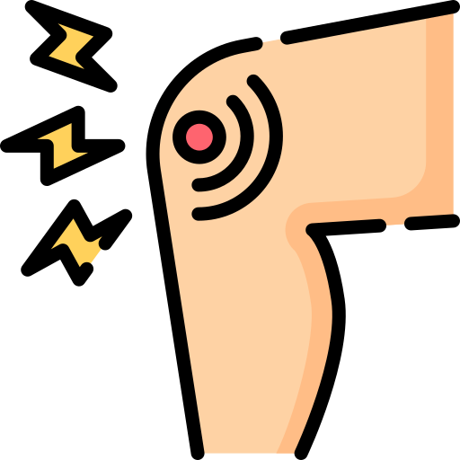
For millions of osteoarthritis (OA) patients, every step is a struggle.
Rae

Slide 6



Symptoms that OA patients struggle with
Of patients experience walking difficulties
80%
Report experiencing sleep disturbances
77%
Face much higher risk of social isolation
47%
Sources: Impact of knee osteoarthritis on the quality of life, 2016, Elsevier Masson SAS. Sleep Disturbance in Osteoarthritis, 2015, American College of Rheumatology. Association Between Osteoarthritis and Social Isolation​, 2019, The American Geriatrics Society.​

Slide 7


Symptoms that OA patients struggle with
Of patients experience walking difficulties
80%
Report experiencing sleep disturbances
77%
Face much higher risk of social isolation
47%
595
million

Slide 8


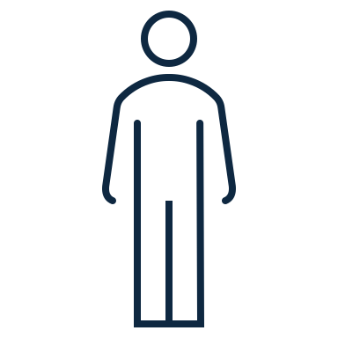
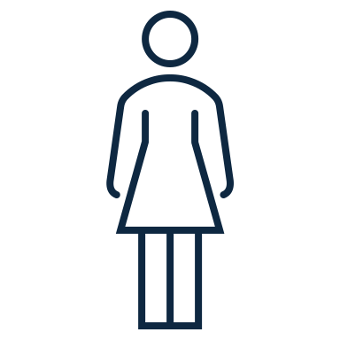


Monetary and physical cost of waiting
2 in 5 elderly aged 70 and older have knee OA
Endure pain
~13 years waiting for knee replacement surgeries
Reduced knee function
Declining quality of life
Incur $12,400 in medical costs
Sources: Global Burden of Disease Study 2021, The Lancet Rheumatology. Lifetime medical costs of knee osteoarthritis management in the United States, 2015, American College of Rheumatology.

Slide 9

Solution
Chavonz & Lavantika

Slide 10

Competitor Analysis
Criteria | Analgesic Patches | NSAIDS | Physiotherapy | TENS Machine
Accessibility
Convenience
Personalisation |  | *
Effectiveness in Improving Condition |  | *
Safety |  | *

Slide 11
Competitor Analysis
Criteria | Analgesic Patches | NSAIDS | Physiotherapy | TENS Machine
Accessibility
Convenience
Personalisation |  | *
Effectiveness in Improving Condition |  | *
Safety |  | *

Slide 12
Competitor Analysis
Criteria | Analgesic Patches | NSAIDS | Physiotherapy | TENS Machine
Accessibility
Convenience
Personalisation |  | *
Effectiveness in Improving Condition |  | *
Safety |  | *

Slide 13
Competitor Analysis
Criteria | Analgesic Patches | NSAIDS | Physiotherapy | TENS Machine
Accessibility
Convenience
Personalisation |  | *
Effectiveness in Improving Condition |  | *
Safety |  | *

Slide 14
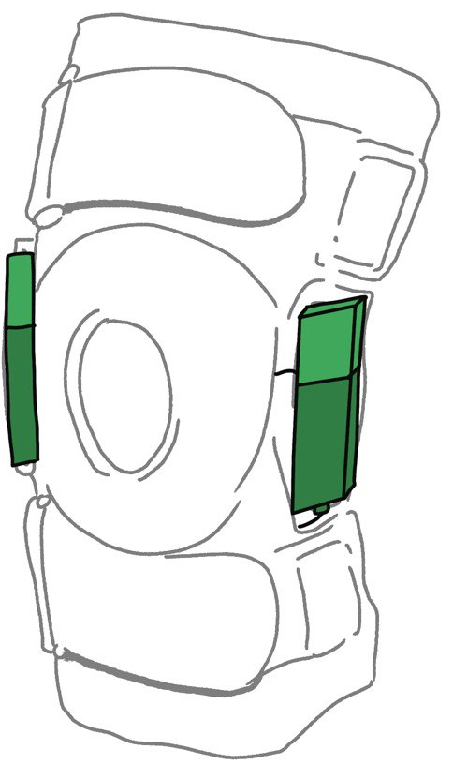

Introducing…
NEUROSTRIDE

Slide 15
How We Lead the Market
Criteria | Analgesic Patches | NSAIDS | Physiotherapy | TENS Machine | Neurostride
Accessibility
Convenience
Personalisation
Effectiveness in Improving Condition
Safety
Inaccessible
Inconvenient
Not Personalised
Not Effective
Not Safe

Slide 16
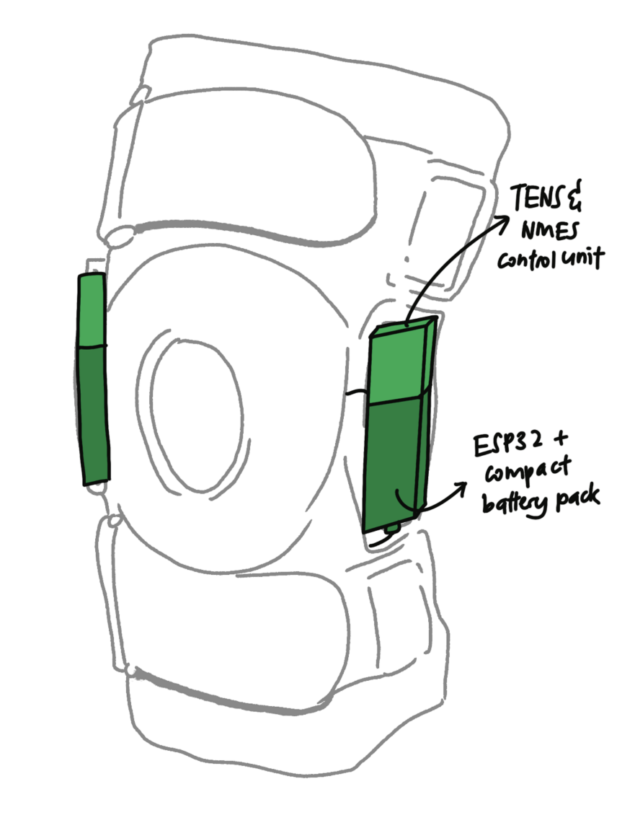
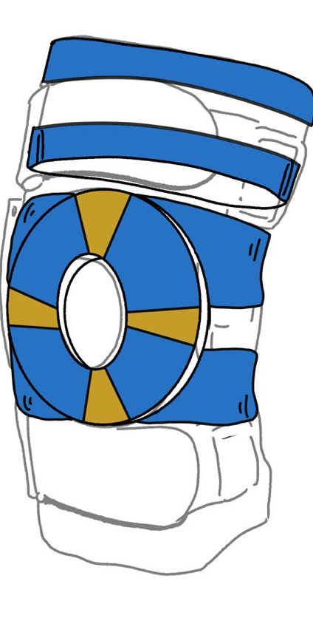
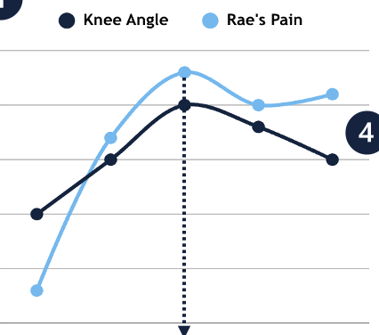



Unique Value Propositions of Neurostride
Duality
Personalization
Comfortable
TENS & NMES
Polyester
Sensors
Lycra Fabric
TENS to provide pain relief
NMES to strengthen muscles
Delivers targeted pain relief to each patient using AI
Lightweight design and comfortable materials

Slide 17
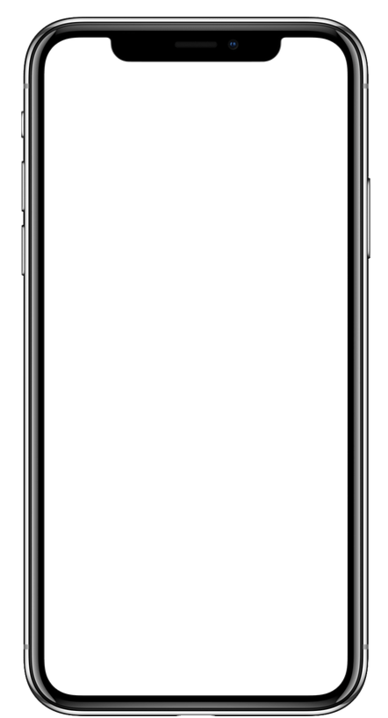
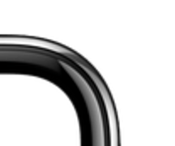

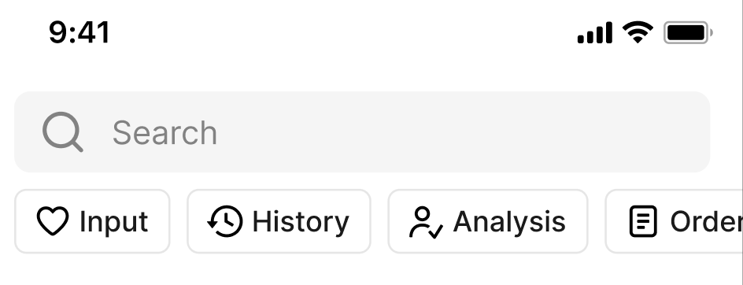
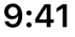


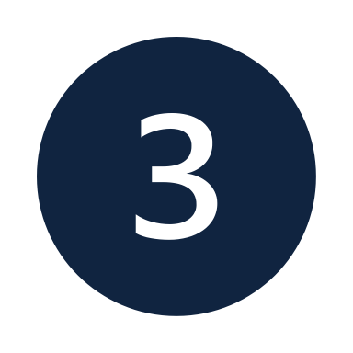

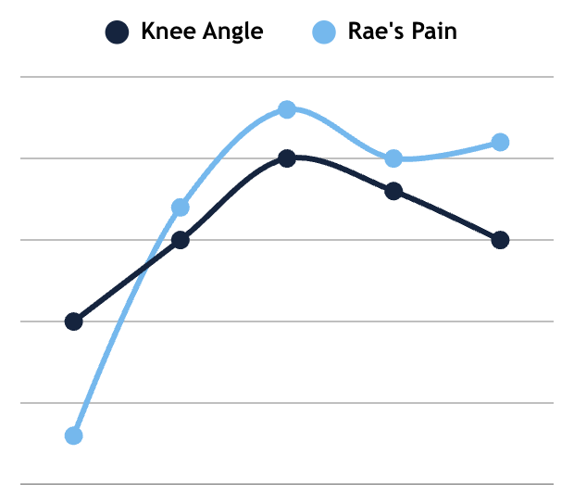
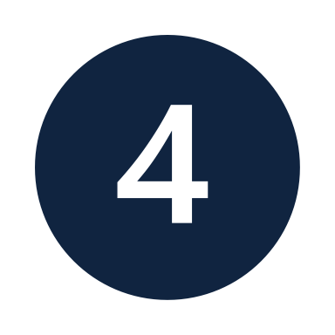
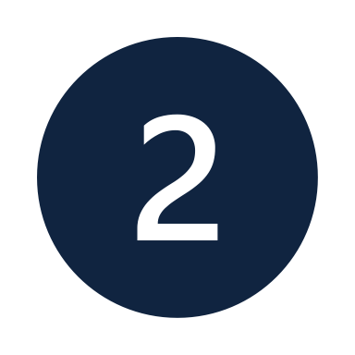
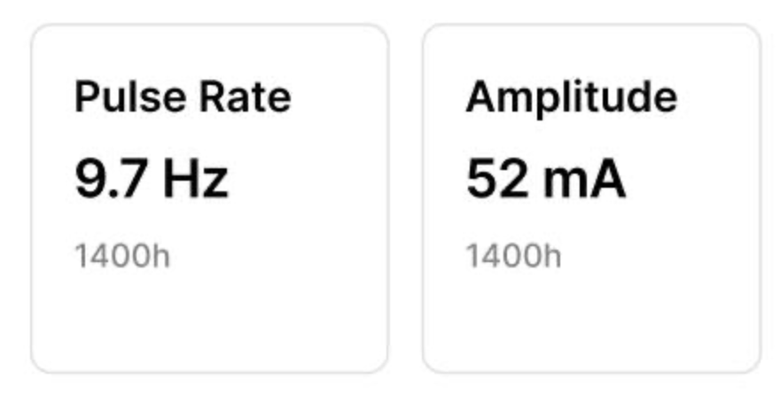
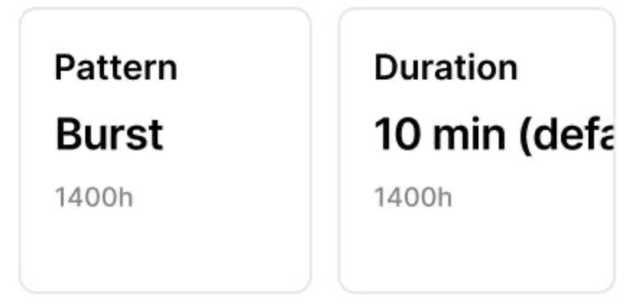
Unique Value Propositions of Neurostride
Key Features
User able to input their pain levels/input stimulations
User able to personalise their pain treatments in real-time
User can access past data and analysis trends
User able to view data as a graph for easy visual aid

Slide 18
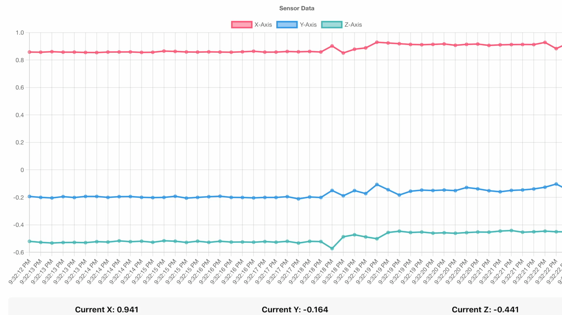

Slide 19

Implementation
Aasish

Slide 20







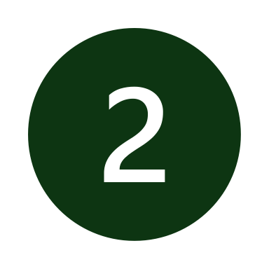


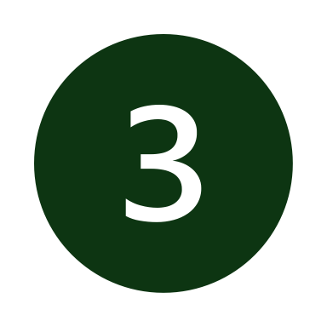
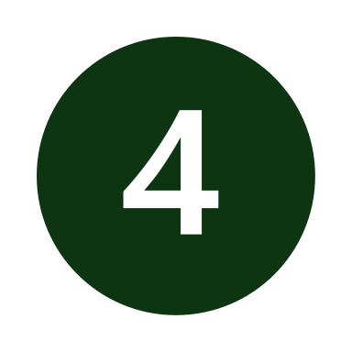
Go To Market Strategy: Expansion Roadmap
Why Singapore?
Rapidly ageing population
Higher average purchasing power
Regulatory efficiency and credibility
Gateway into Asian markets

Slide 21

Go To Market Strategy: Expansion Roadmap
Why Singapore?
Market Entry Strategy: B2B
Rapidly ageing population
Product needs to be medically guided
Higher average purchasing power
Reduced marketing costs
Regulatory efficiency and credibility
Enhances credibility in the eyes of patient
Gateway into Asian markets

Slide 22

Product Implementation Roadmap
Key Milestones
Final Product Completion
Pre-Launch Phase
Functional Prototype Completion
Official Launch
Expansion Phase
2025 |  |  |  | 2026 |  |  |  | 2027 |  |  |  | 2028 |  |  |  | 2029 |  |  |  | 2030 |  |  |  | 2031 |  |  |  | 2032
Prototyping
Securing IP
Approvals & Clinical Trials
Mass Manufacturing
Go-To-Market
Pre-Launch
Patent Protection
Trademark Protection
Clinical Trials
Expansion
Start in Singapore

Slide 23


Key Drivers and Outcomes
Cost Levers
Prototyping
$9,000
Securing IP
$7,450
Pre- Launch
Approvals & Clinical Trials
$324,362
Manufacturing Cost of 1 unit
$37.31
Expansion
Retail Price of $93.95/unit
89.4% reduction in annual expenses

Slide 24



Key Drivers and Outcomes
Cost Levers
Business Projections (in Singapore)
Prototyping
$9,000
Total Addressable Market
316,054,459
Securing IP
$7,450
Service Addressable Market
161,700
Pre- Launch
Approvals & Clinical Trials
$324,362
Service Obtainable Market
1617
Manufacturing Cost of 1 unit
$37.31
Expansion
Market Size of ~$151,917
Retail Price of $93.95/unit
Market Size of ~$296,933,164
89.4% reduction in annual expenses

Slide 25




What sets us apart?
CLARA
CHAVONZ
LAVANTIKA
AASISH
Medical Lead
Tech Lead
Hardware Lead
Strategy Lead
Medicine student in NTU
Top 15 in Asia
Computer Engineering student in NTU
Ranked #6 worldwide
Electrical Engineering student in NTU
Ranked #4 worldwide
Technology Management student in NTU
Ranked #6 worldwide

Slide 26
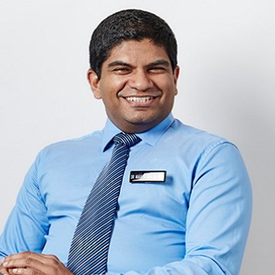
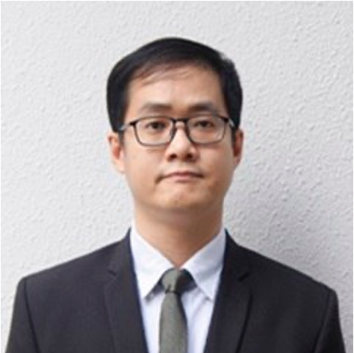

Our Incredible Mentors
Dr Nagaendran
Dr Chi Wei
Dr Wei Chin
Medical Mentor
Tech Mentor
Medical Mentor
Senior Neurologist and Clinician Scientist with National Medical Research Council
PhD in Biomedical Engineering (NUS)
MedTech Startup Founder
Student Chair of Singapore Biomedical Engineering Society
Senior Consultant at the Department of Geriatric Medicine at Tan Tock Seng Hospital

Slide 27
Choose Neurostride!
A New Era of Mobility Starts Here
Clara
Chavonz
Lavantika
Aasish

Slide 28

Q&A
By the Team

Slide 29
Q&A Slide Network
Clinical Perspective
Technical Perspective
Business Perspective
What are our justifications for our target demographic?
Clinical Metrics of OA pain
How do we ensure safety of Neurostride?
How does NMES Technology?
What is the clinical administration of TENS and NMES?
What is the recommended administration of TENS and NMES?
Hardware
What is our implementation route?
Phase 1: Prototyping
Phase 2: IP Protection
Phase 3.1: Regulatory Approval
Phase 3.2: Clinical Trials
Phase 4: Mass Manufacturing
What is the market we intend to capture?
Why did we choose a B2B model over B2C?
How are you going to distribute the funding you receive?
What is the manufacturing cost of each unit?
What is the retail price of each unit?
Is there any case study to prove how feasible Neurostride is?
How is TENS administered?
What are the sensors we are using?
Software
What are the variable inputs and outputs to train the model?
How exactly does the AI work?
Where are we running our inferences?
What are your false positive/negative cases?
What machine learning method are we using?
What is our system architecture like?
Design Considerations
What are our design considerations behind rubber electrodes?
What materials are we using in Neurostride?

Slide 30
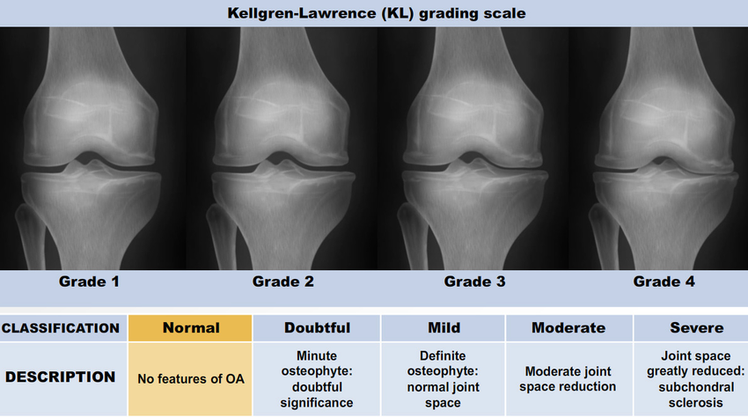
What are our justifications for our target demographic?
Filling the current gap in healthcare
The definitive treatment for knee OA is still total knee arthroplasty (TKA). NeuroStride’s role in healthcare is not to replace TKA but to target patient populations which need pain management, which include the following:
Patients who don’t want surgery
Patients waiting for surgery
Patients who still experience pain post-surgery
Why target knee OA specifically?
The knee is the most common site of osteoarthritis, based on a 2020 global age-standardised systemic analysis in the Lancet.
Which stage of knee OA would TENS be relevant for?
We recommend starting NeuroStride at Stage 2 of OA where doctors start prescribing analgesics to deal with OA pain.
Stage 3 – higher frequency TENS recommended
Stage 4 – TKA recommended, hence TENS will only be for patients awaiting surgery / experience post-operative pain

Slide 31
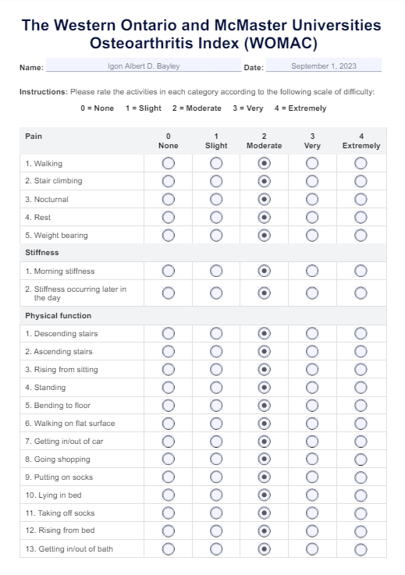
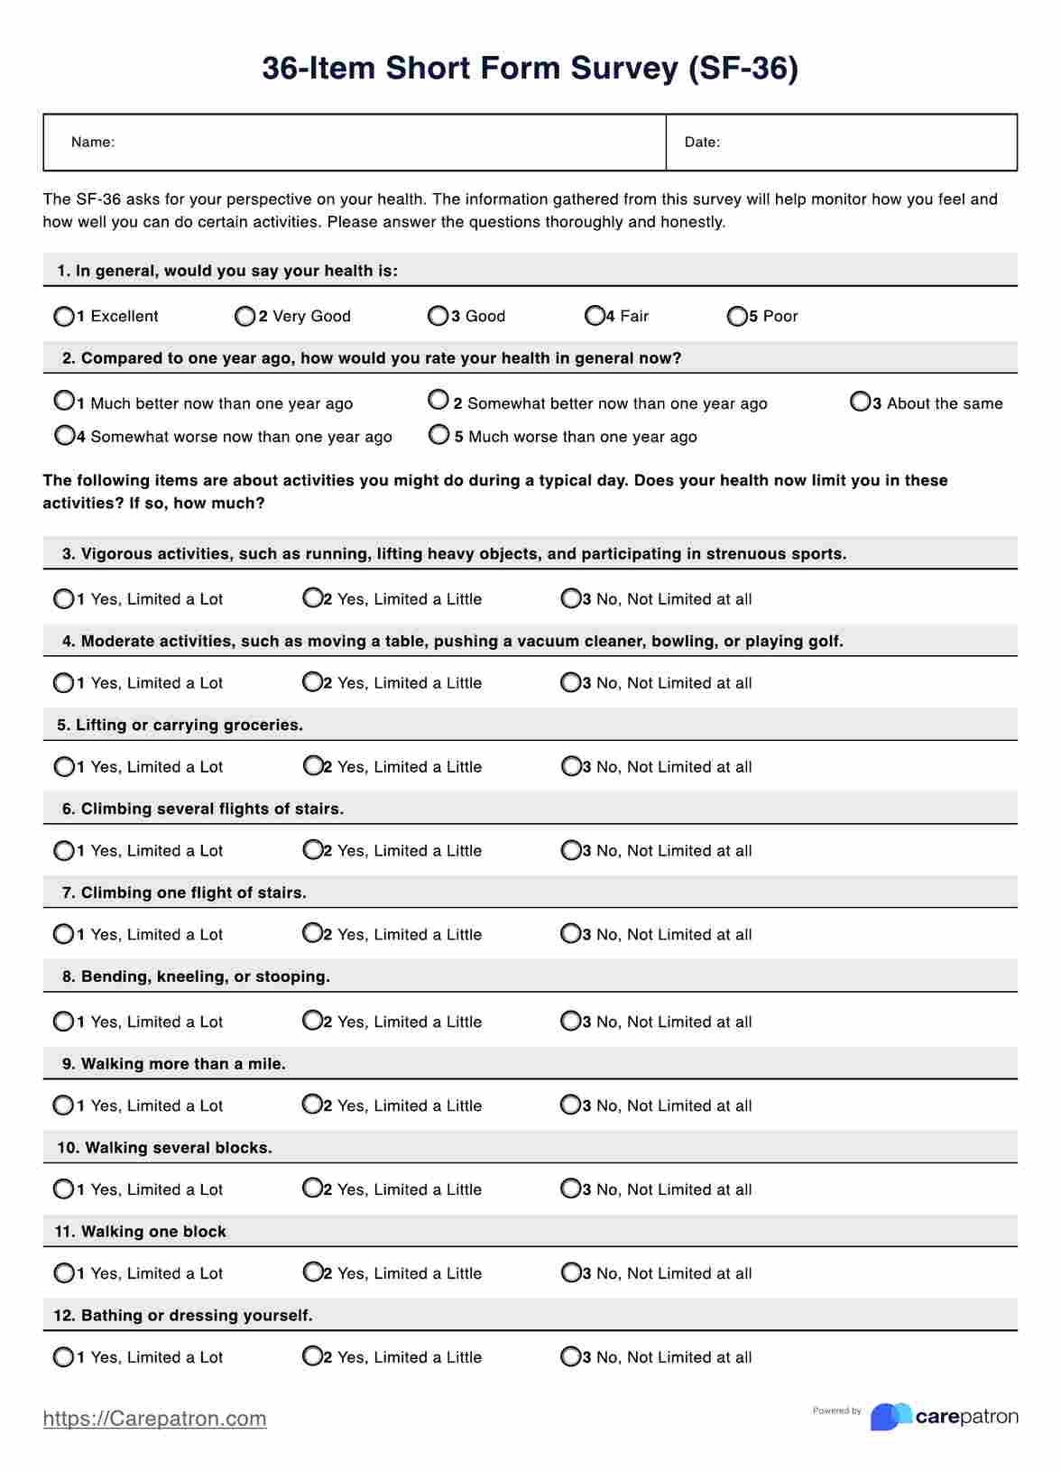
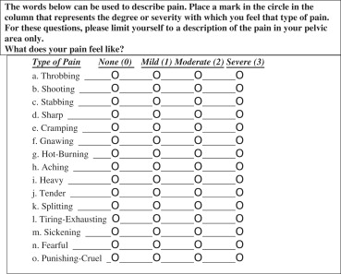
Clinical Metrics of OA pain
1
Short form McGill Pain Questionnaire
McMaster Universities Osteoarthritis Index (WOMAC)
2
Medical Outcomes Study Short-Form 36 (SF-36) scales
3

Slide 32
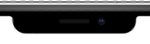
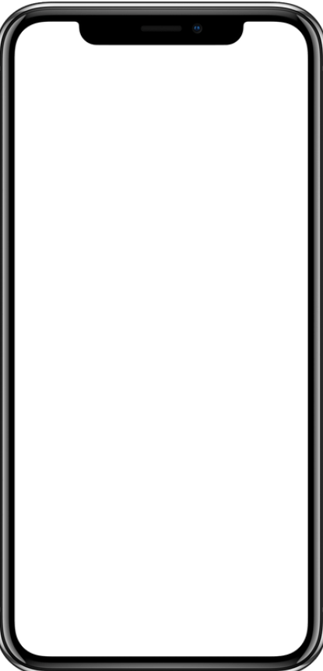
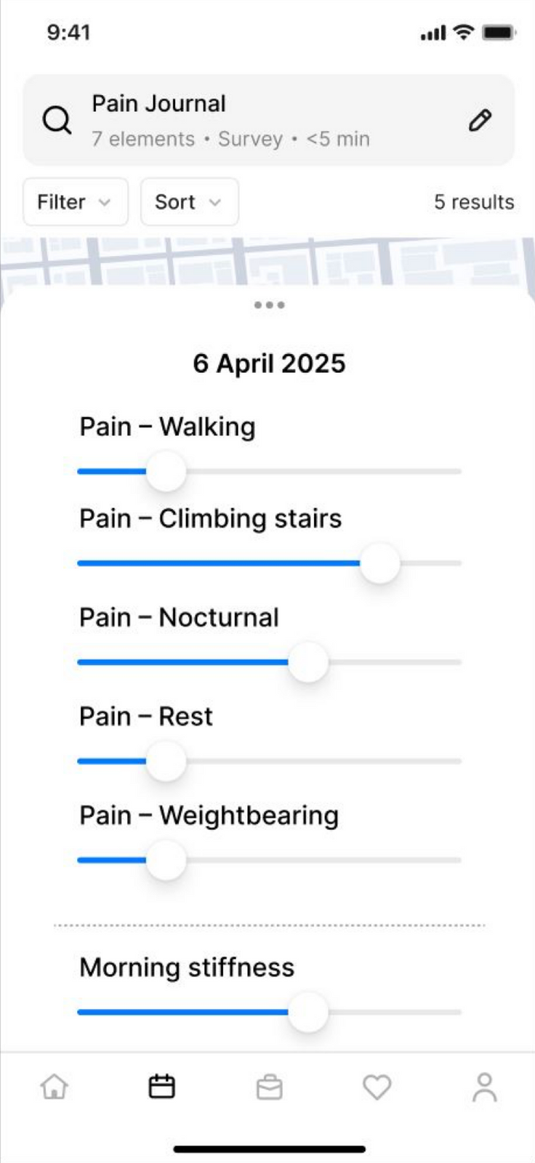
Clinical Metrics of OA pain
1
Short form McGill Pain Questionnaire
McMaster Universities Osteoarthritis Index (WOMAC)
2
Medical Outcomes Study Short-Form 36 (SF-36) scales
3
“Pain” journal enables patients to track their pain levels at the end of each day, using a shortened version of WOMAC
Application of pain metrics:
For clinician to monitor progress of OA condition
To track the effectiveness of NeuroStride

Slide 33

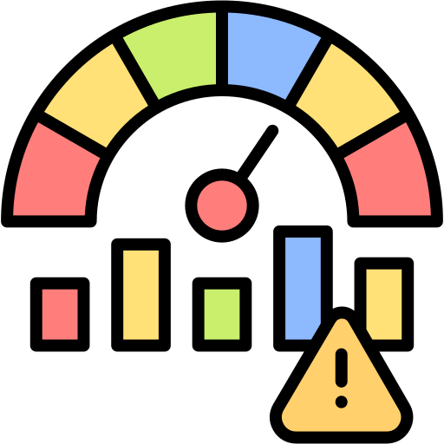

Ensuring safety of NeuroStride (1)
Possible issues that may arise with usage of NeuroStride:
Issue 1: With instantaneous pain alleviation, the patient may have a false sense of security even if their OA is worsening. They may skip follow-ups and treatments, preferring to use TENS as a temporary solution instead.
Issue 2: Patients may build up analgesic tolerance with repeated use of TENS, resulting in a decrease of efficacy overtime.
Issue 3: Certain patients may experience skin irritation and redness with prolonged use of the electrode pads, or under prolonged high intensity of TENS and NMES.

Slide 34
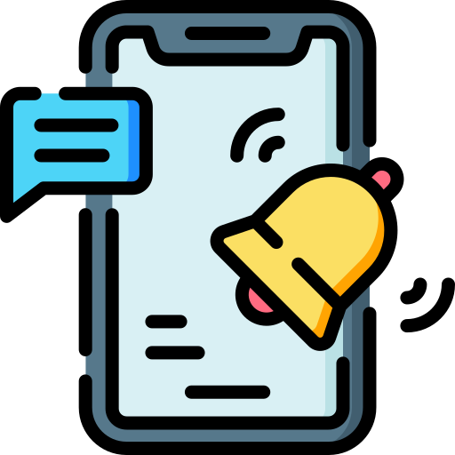

Ensuring safety of NeuroStride (2)
Our solutions
Quarterly notifications in our app will urge the patient to go back to the doctor for a review. If the notification is insufficient, future updates can include the suspension of app usage until they visit their healthcare professional.
Issue 1: With instantaneous pain alleviation, the patient may have a false sense of security even if their OA is worsening. They may skip follow-ups and treatments, preferring to use TENS as a temporary solution instead.
Data collected through our app (mainly the level of activity and the trends in chronic pain experienced) will be made available to the healthcare provider for physicians to track and decide when they need a review.

Slide 35

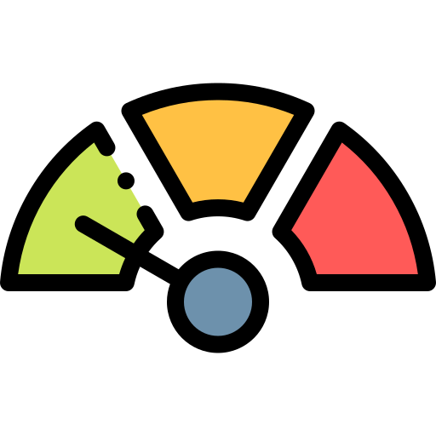
Ensuring safety of NeuroStride (3)
Our solutions
Manual guide will include advisory to patients to have breaks in between TENs usage to avoid building up tolerance.
Issue 2: Patients may build up analgesic tolerance with repeated use of TENS, resulting in a decrease of efficacy overtime.
Default will be set to a lower intensity and modulated in pattern. Patients are able to vary their intensity manually to a higher level to overcome analgesic tolerance.

Slide 36

Ensuring safety of NeuroStride (4)
Our solutions
Manual guide will provide ways in which the patient can ensure hygiene and prolong the shelf life of their TENs electrode pads.
Issue 3: Certain patients may experience skin irritation and redness with prolonged use of the electrode pads, or under prolonged high intensity of TENS and NMES.
Recommended shelf life for TENs electrode pads will be clearly stated and a digital alert will be made available for patients to change their electrode pads post-expiry.

Slide 37
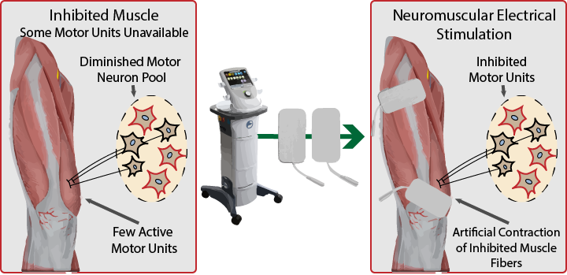
How does NMES Technology work?
Clinical Aspect:
NMES sends higher intensity pulses to motor nerves. This causes involuntary muscle contraction which mimics voluntary exercise
Helps to prevent muscle atrophy and strengthen the quadriceps, which are key to knee stability in OA patients
Technical Aspect:
Duration: 10-20 minutes (with duty cycles to reduce fatigue)
2 Electrode Pads placed over the vastus medialis and lateralis (Quadricep Muscles) → Cathode and Anode are separated through a non-conductive fabric
Elderly (>65 years) — normally use lower frequency of 30-40 Hz with longer rest periods
Neurostride incorporates user metadata like age, weight, physical activity level and injury history to suggest NMES intensity
27%
Greater quadricep strength recovery compared to without NMES therapy .
12%
Further distance travelled in 6 minutes at both 3 and 6 weeks post-op compared to without NMES therapy.

Slide 38
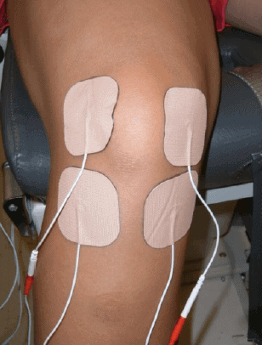
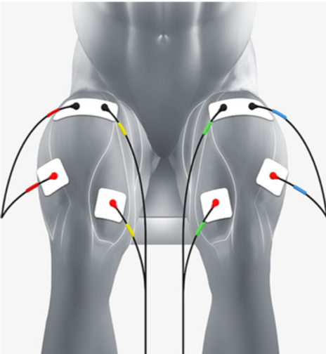
What is the clinical administration of TENS and NMES? (1)
Physiology of TENS
Physiology of NMES
Subcutaneous electrical stimulation of nerves to reduce the sensation of pain
Electrical stimulation of motor neurons causing depolarization of neurons and muscle contraction
High frequencies (50-150 Hz) activate the delta-opioid and muscarinic receptors which modulates pain nociception
Low frequencies (1-10 Hz) activate the mu-opioid receptors and cause the brain to release endorphins
An electrically stimulated muscle contraction elicits initial responses from larger motor units, which contain a greater number of fatigable, type II muscle fibres

Slide 39
What is the clinical administration of TENS and NMES? (2)
Variable parameters of TENS and NMES
 | TENS | NMES
Frequency (Pulse Rate) | Frequency range: 1-150 Hz Low frequency: 1-10 Hz Stimulate μ-opioid receptors that causes the brain to release endorphins High frequency: 50-150 Hz Stimulates δ-opioid receptors that inhibit pain nociception | Frequency range: 35-50 Hz Tetanic frequency lies within this range; typical critical frequency at which a muscle will respond with a smooth contraction
Intensity (Amplitude) | Amplitude range: ≤ 70 mA Higher intensities titrated according to individual tolerance for a stronger TENS sensation without skin irritation | Amplitude range: ≤ 100 mA Higher intensities than NMES in order to cause stronger muscle contraction

Slide 40
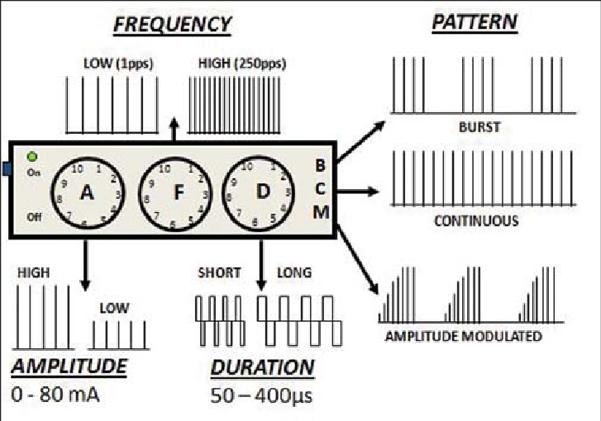
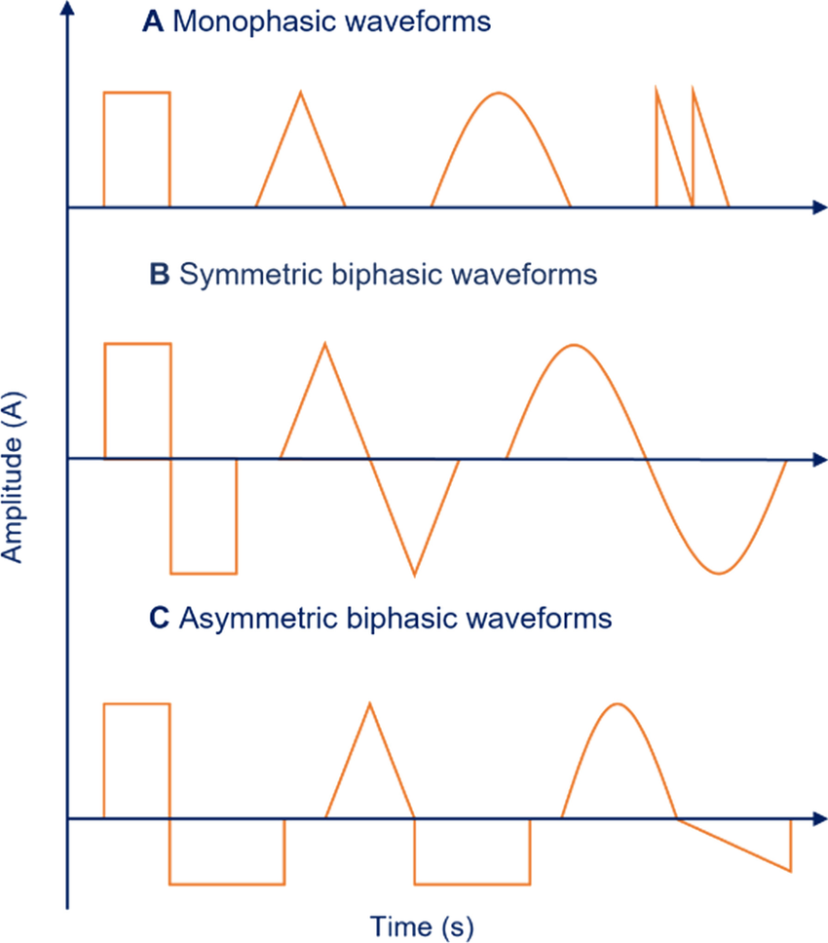
What is the clinical administration of TENS and NMES? (3)
Variable parameters of TENS and NMES
 | TENS | NMES
Pulse width (Pulse Duration) | Pulse width: 1-400μs Higher the pulse width the more stimulation a patient feels as small unmyelinated fibers (most opioid nerve fibers) respond to long pulse widths (200μs) | Pulse width: 400-600 μs Shorter waveforms require a greater current amplitude to produce a muscle contraction Longer-phase durations may be used to optimize torque production but are less comfortable.
Pulse pattern | 3 different modes: continuous, burst, modulated | 2 different waveforms: symmetric or asymmetric biphasic pulse

Slide 41
Recommended administration of TENS and NMES
 | TENS | NMES
Default / most ideal parameters | Conventional TENS: biphasic TENS currents with a high frequency (50-150Hz), low intensity (up to patient’s tolerance), and low pulse width (50-200 μs), continuous pulse pattern Acupuncture-like TENS: low frequency, high intensity, and high pulse width (100-400 μs) (for patients who are unable to tolerate conventional TENS | Biphasic pulsed currents of 100–400 μs delivered at stimulation frequencies of 50–100 Hz at the highest tolerated current intensity, pulse pattern accounts for duty cycles of rest and stimulation set at 1:1 default Higher intensity and lower pulse frequencies than TENS)
Electrode placement | Across the knee area in a cross formation | Longitudinal placement of NMES covering the greatest area across quadriceps muscle
AI application | After 2-week trial period, a predictive algorithm will be updated weekly to deliver TENS jolts. | NIL, NMES is manually applied
Administration schedule | Throughout the day, for 10-15 mins each session, capped at 2 hours each day to prevent analgesic tolerance | At the end of each day, patient will have a scheduled session for about 20-30 minutes of strengthening
Adjustable parameters (in app)
Intensity
Frequency
Pulse pattern
Jolt duration

Slide 42
How is TENS administered — how are the parameters varied?
Parameter | Pulse Frequency | Pulse Pattern | Pulse Intensity | Total Session Duration
Control Mechanism | Typical Pulse frequency — 50-150Hz Controlled via software timers (timers are implemented via Arduino software) | ESP32 has 2 built-in DACs which can generate smooth sine, biphasic or monophasic analog waveforms | Managed through a Constant Current Source Circuit Reference voltage is set and adjusted by the ESP32 | Managed via software timers (timers are implemented via Arduino software) Session lasts for 10-15 minutes once triggered
Usage Considerations | (No specific unique consideration for width itself, but it contributes to stimulation comfort and efficacy) | Biphasic waveforms are generally used for comfort and balanced charge delivery Square pulses which are more common in NMES/TENS, use digital PWM to toggle GPIO pins at high speed | Patients conduct and regulate current intensity through the constant current circuit for personalized comfort | System stops tracking user parameters during the session Total TENS duration will be capped at 2 hours a day to avoid building up analgesic tolerance
Wave Generation | Defined by timer intervals and pulse duration coded into the firmware/software | Simulated using Pulse Width Modulation (PWM) or Digital-to-Analog Converters (DACs) | Intensity is controlled by modifying current through DAC-regulated reference voltage in the current source circuit | Defined by timer intervals and duration coded into the firmware/software

Slide 43

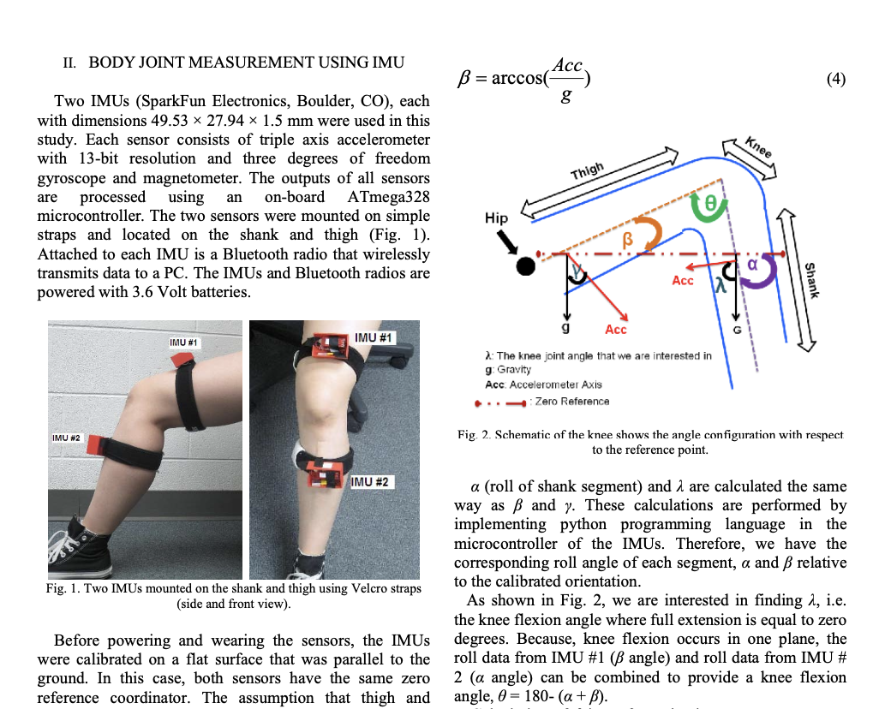
What are the sensors we are using?
IMU (Inertial Measurement Unit)
Tracks movement in the x, y and z axis
Two IMU sensors will be placed above and below the knee to calculate the relative angle of the knee
Gait Speed can also be calculated using this sensor
How does Gait Speed correlate to pain?
The patient’s movement becomes more jerky / interrupted as they try not to place too much pressure on the knee in pain
Unstable gait indicates the bones rubbing together more which would lead to more pain
EMG (Electromyography)
How to remove noise?
Use a Bandpass filtering system (20-500Hz) that removes low frequency drift and high frequency noise
Detect abnormal activities such as :
Drop in average EMG amplitude
Delayed onset in VMO vs VL
Prolonged co-activation of antagonists
Spikes in EMG variance during motion
Notes:
The two systems mostly agree, with small differences ranging from 0.08° to 3.06°.
That level of difference is very accurate, even better than what’s typically accepted in medical clinics.

Slide 44
What are the variable inputs to train the model?
Sensor | IMU Sensor | EMG Sensor
Raw Data/Input | x,y,z coordinates • Linear acceleration (from accelerometer) – measures changes in velocity along the x, y, and z axes • Angular velocity (from gyroscope) – measures rotational speed around the x, y, and z axes | Mean, Median Frequency and Power Spectral Density
Processed Data | Knee angle (via quaternion/Euler angle), Gait speed (via accelerometer & gyroscope) | Frequency domain detection (detect abnormalities → faster muscle fatigue)
Output Parameters | Pulse intensity, pulse frequency, pattern, duration (based on TENS/NMES current, voltage,etc.)

Slide 45

How exactly does the AI work? (1)
Where are we running the inferences? On a phone app as it is the best of both worlds
 | Description | Pros | Cons
Locally | Inference runs directly on Neurostride using a microcontroller with a built-in GPU | No Connection Needed Low Latency | Limited Processing Difficult to update model
Cloud | Inference runs on a cloud server as the sensor data is continuously sent to the cloud via wifi | High Processing Power Scalable | Needs Constant Internet Access High Latency High Cost/Inference (Adds up fast when running continuous inferences)
Phone App | Inference runs on the phone as the sensor data is continuously sent to the phone via bluetooth module on Neurostride | High Processing Power (Due to built-in GPU) Scalable Low Latency No Connection Needed | Relies on phone being nearby

Slide 46
How exactly does the AI work? (2)
Where are we running the inferences? On a phone app as it is the best of both worlds
The phone is only used to run inferences, not to train the AI model itself as it requires lots of memory, GPU power and battery.
Instead, it can collect the data from the sensors on Neurostride and sends it to the cloud for retraining periodically (once a week). This will ensure Neurostride is continuously personalised to the patient itself.

Slide 47
How exactly does the AI work? (3)
After the 2 week calibration period, what happens if Neurostride administers a jolt when it is not needed? Or it does not administer a jolt when it is needed? How does the AI account for that and continuously learn?
Case 1: False Positive
Neurostride administers a jolt when it is not needed OR Neurostride administers a jolt that is needed but the Pulse Rate, Amplitude, Pattern or Duration was incorrect
Solution: The patient can use the app and click on the dotted line to access the jolts delivered and update it to the specific metrics he is looking for.
Case 2: False Negative
Neurostride does not administer a jolt when it is needed
Solution: The patient can use the app and deliver the jolts according to the specific metrics he is looking for.

Slide 48
How exactly does the AI work? (4)
What Machine Learning method are you using?
We are using Supervised Learning. Why?
1. Our data structure is most ideal for Supervised Learning
Models are trained on labeled data, where each input has a known output. This aligns perfectly with Neurostride’s goals, where sensor data collected can be labeled during clinical trials (Baseline Model) and during the 2-week initiation period.
2. Other methods like Reinforcement Learning is not safe
Reinforcement learning works by trial and error to maximize rewards — it may experiment with random “jolts” or feedback to see what yields a better outcome, which can be unsafe or even harmful in a medical context where unintended actions could negatively affect a patient’s condition.

Slide 49
What is our system architecture like?
Locally on Neurostride
Flow
1. ESP32 collects EMG + IMU data → sends via Bluetooth
2. Mobile app receives data → runs local ML inference
3. App gives activates TENS and NMES in real-time
4. App logs data, and uploads to AWS weekly
5. AWS retrains model and stores updated version
6. App downloads new model and replaces local one weekly
Mobile Application
Cloud
TENS Module
IMU Sensor
React Frontend
AWS Cloud Storage
ESP32 Microcontroller
Bluetooth
(every second)
Wifi
(every week)
Inference Engine
AWS Cloud Model Training
EMG Sensor
Bluetooth
(every second)
Wifi
(every week)
Sources: https://reefwing.medium.com/an-arduino-library-for-the-x-imu3-gui-imu-data-visualisation-tool-e5aaacf894a7
https://medium.com/the-research-nest/how-to-log-data-in-real-time-on-a-web-page-using-flask-socketio-in-python-fb55f9dad100

Slide 50
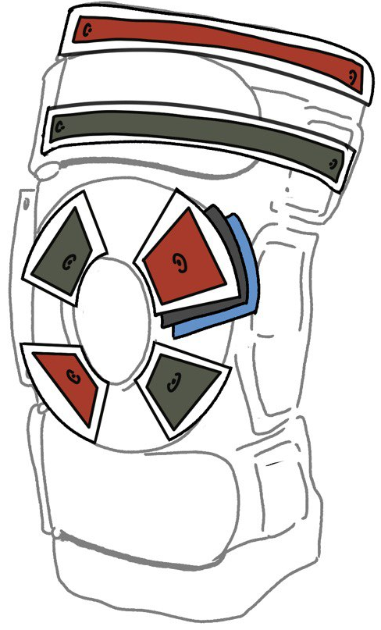
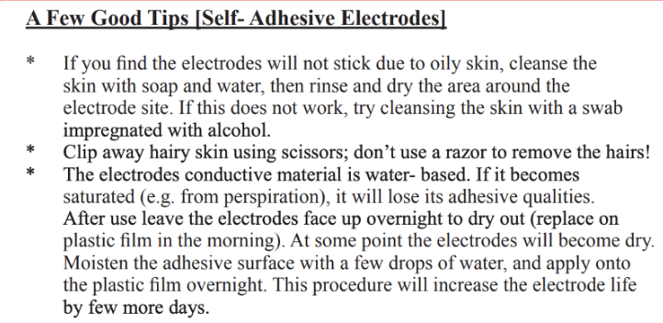
What are our design considerations behind rubber electrodes?
Regular electrodes (4-6 weeks)
2. Rubber electrodes (3 months)
Less maintenance than Self-Adhesive Electrode
Just strap it on and wipe with alcohol wipes after each use
Carbonized rubber electrodes showed superior performance compared to sticky (gel-based) electrodes
1. Skin impedance: 53 kΩ vs 98 kΩ → 84.9% better
2. % of maximal voluntary contraction: 21.2% vs 12% → 76.7% better
3. Quadriceps torque produced: 33.5 N·m vs 17.9 N·m → 87.5% better
4. The lower skin impedance (~half) with rubber electrodes allows more comfortable stimulation, enabling nearly double the muscle activation and torque output, leading to a stronger training effect.
https://cdn.competec.ch/documents2/4/3/9/203170934/203170934.pdf?

Slide 51
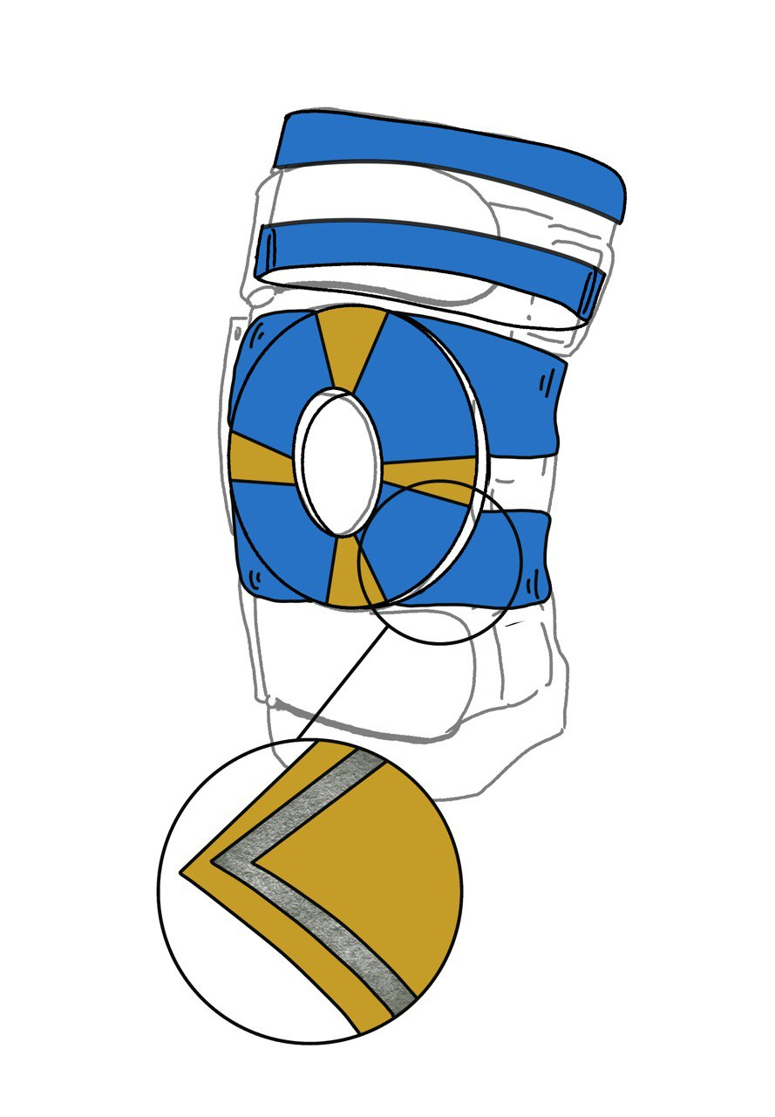
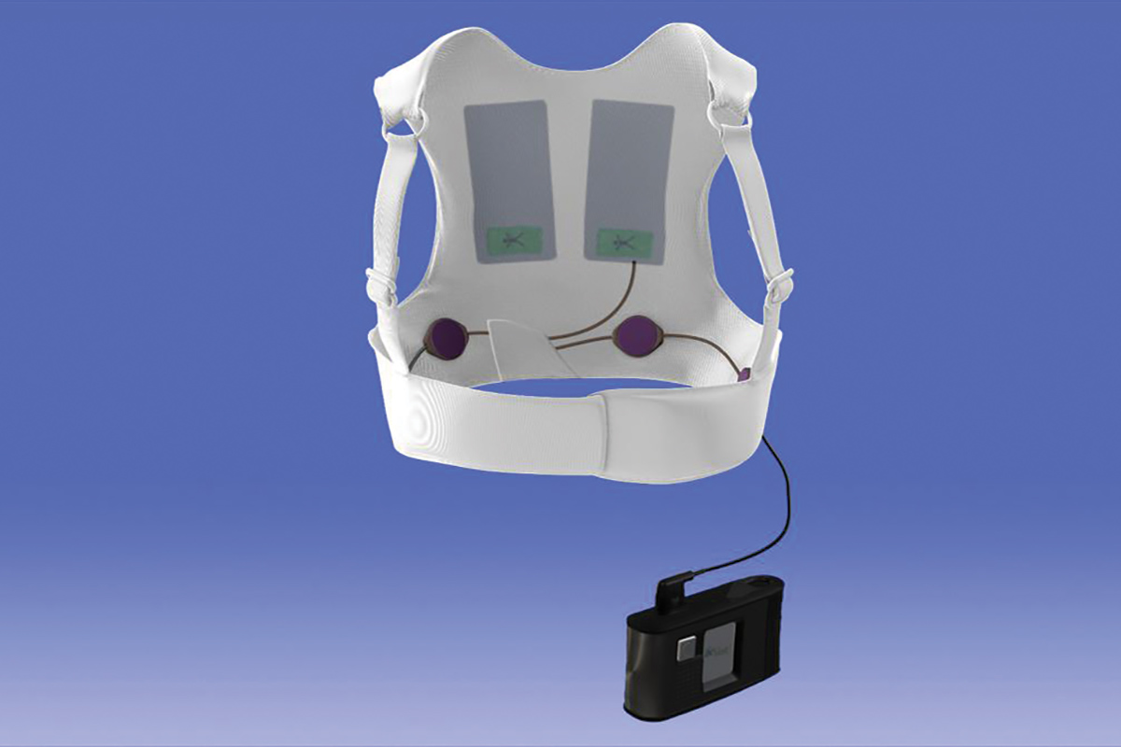
What materials are we using in Neurostride? (1)
Electrode Patch: (in blue)
Layer 1 & 3: Lycra Fabric
Insulating fabric between electrodes to separate cathode and anode.
Layer 2: Carbon fiber fabric
Properties:
Conductive — carry current efficiently to electrodes
Flexible and durable — allows the conductive electrodes to maintain contact with the skin
Method:
Use twill-weaved carbon fiber fabric to increase flexibility and comfort of the brace
Conductive Carbon
Fiber Fabric
Case Study: Wearable Cardioverter Defibrillator (WCD) — conductive textiles within a vest-like garment to house electrodes that monitor heart's rhythm and deliver defibrillation shocks
Insulating Lycra
Fabric
Twill Weaved
Carbon Fiber

Slide 52
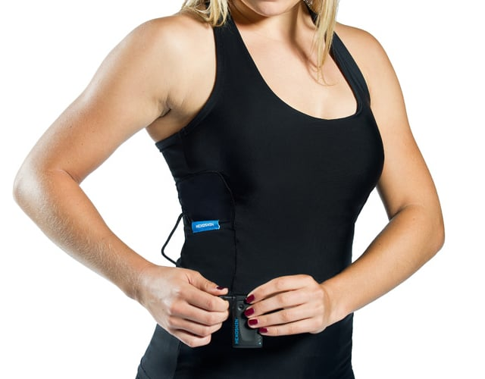
What materials are we using in Neurostride? (2)
Knee Guard:
3 Layers of Polyester Fabric:
Properties:
Comfortable
Breathability & Moisture wicking — Reduces skin irritation and sweat accumulation
Case Study: Hexoskin Smart Shirts — lightweight, moisture-wicking, and stretches well
Conductive Carbon
Fiber Fabric
Insulating Lycra
Fabric
Twill Weaved
Carbon Fiber

Slide 53
What materials are we using in Neurostride? (3)
Properties | Carbon Fiber Fabric | Polyester Fabric | Lycra Fabric
Reusability | Reusable in dry fabric form. | Highly reusable for textile purposes. | Reusable in clothing and athletic wear.
Durability | High Tensile strength. Good surface durability due to tight interlacing. Resist degradation over cyclic stress. | High Tensile strength. Good surface durability. High resistance to piling and abrasion. | Moderate strength. Focuses on elasticity. Extremely flexible and stretchable (up to 500%).
Cleanability | Easy to wipe clean. Do not absorb stains. | Machine washable. Good stain resistance. | Easy to clean but requires gentle care.
Conductive Carbon
Fiber Fabric
Insulating Lycra
Fabric
Twill Weaved
Carbon Fiber

Slide 54
Product Implementation Roadmap (Recap)
Key Milestones
Final Product Completion
Pre-Launch Phase
Functional Prototype Completion
Official Launch
Expansion Phase
2025 |  |  |  | 2026 |  |  |  | 2027 |  |  |  | 2028 |  |  |  | 2029 |  |  |  | 2030 |  |  |  | 2031 |  |  |  | 2032
Prototyping
Securing IP
Approvals & Clinical Trials
Mass Manufacturing
Go-To-Market
Pre-Launch Phase
Patent Protection
Trademark Protection
Clinical Trials
Expansion
Start in Singapore

Slide 55
Detailed Implementation Timeline (1)
Phase 1
Prototyping
Purpose of this Phase
1. To build a functional prototype with all the necessary sensors and safety features to be used in clinical trials subsequently 2. Build final product to be launched on the market
What is the process like?
Source for suitable sensors, TENS and NMES components (based on size, battery power, etc). Incorporate them into the device and find the most optimal and compact arrangement [Hardware]
Incorporate the different layers (2x fabric layer, 1x conductive carbon fibre layer) into the [Materials]
AI model will be trained during clinical trials phase; Application frontend and backend to be developed as well [Software]
Projected Duration
~1 year for functional prototype
~6 years for final product (alongside clinical trials)

Slide 56
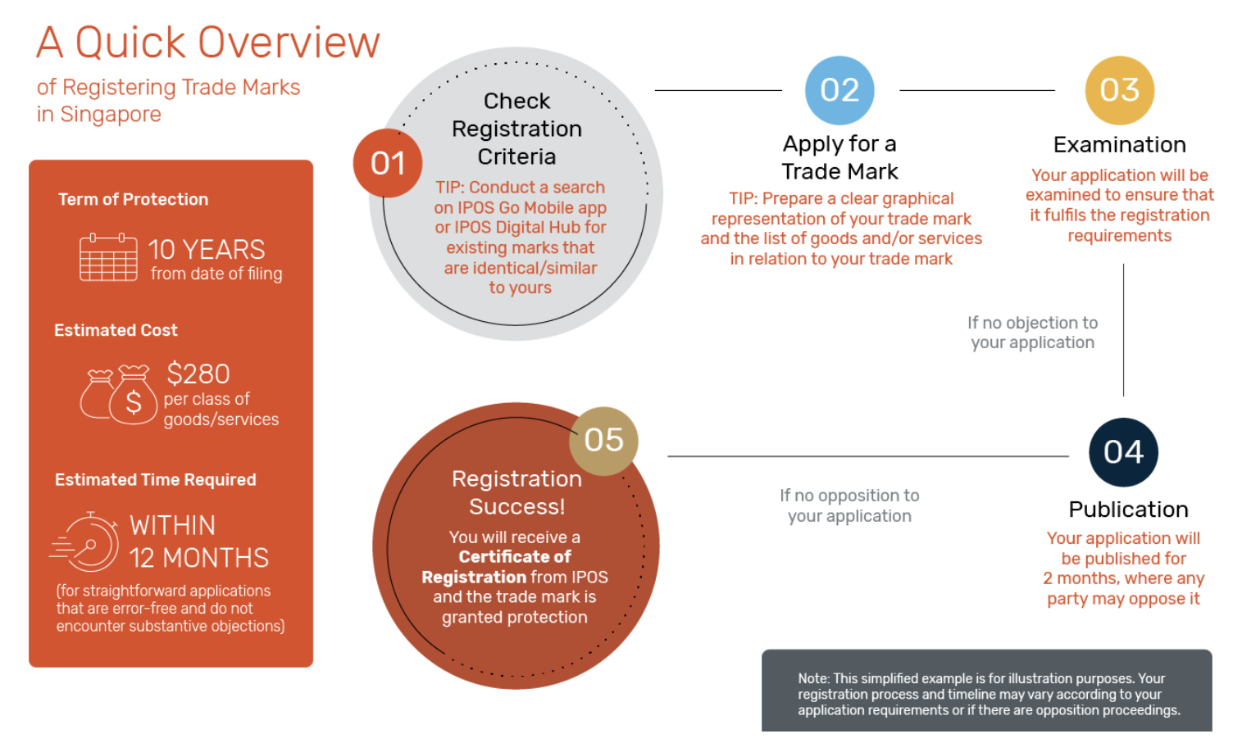
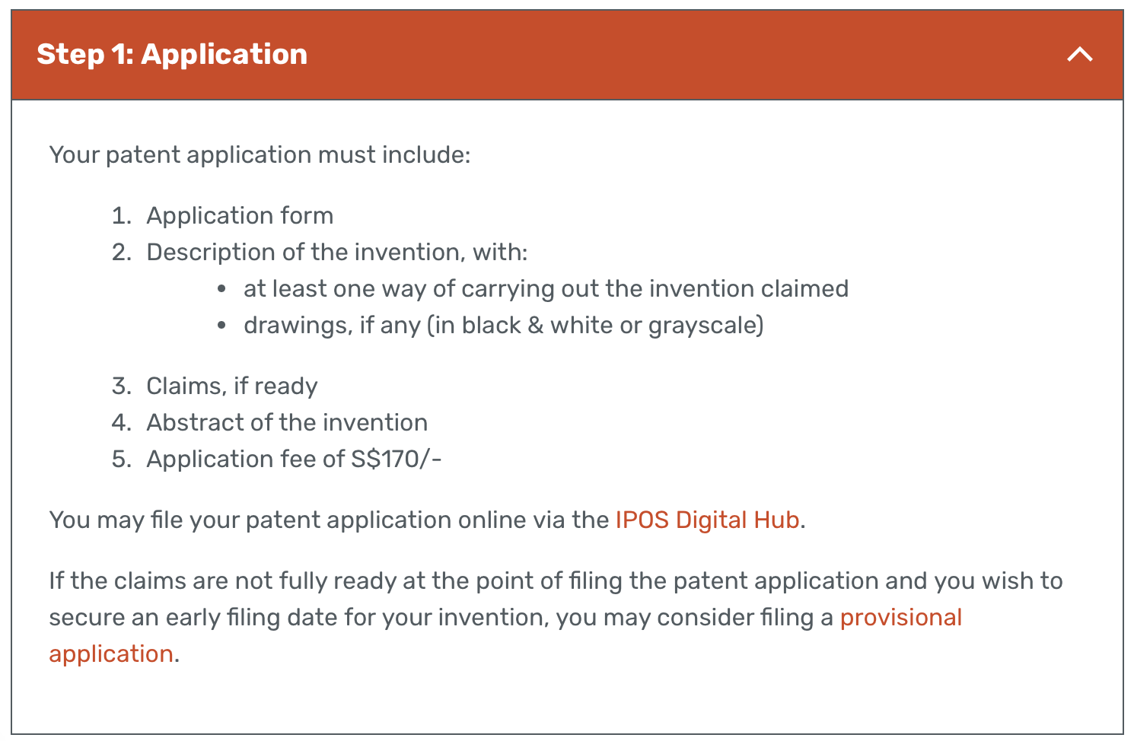
Detailed Implementation Timeline (2)
Phase 2
Securing Intellectual Property
Purpose of this Phase
Apply for 1. Patent Protection and 2. Trademark Protection to safeguard our invention and protect brand elements
What is the process like?
Draft a detailed patent specification outlining the invention's novelty and inventive step
Submit the application to the Intellectual Property Office of Singapore
Search: Conduct a trademark search to ensure no similar marks exist​
Filing: Submit the application to IPOS, specifying the classes of goods or services
Publication: The mark is published in the Trade Marks Journal for public opposition
Engage IP lawyers to facilitate the process
Source: IPOS Website
Projected Duration
Patent Protection: 2 to 4 years, depending on the complexity
Trademark Protection: 8-12 months

Slide 57



Detailed Implementation Timeline (3.1)
Phase 3.1
Regulatory Approval Pathway
Purpose of this Phase
Ensure safety of our device before beginning clinical trials (the safety of the idea itself has already been verified by LKC Medicine Department)
What is the process like?
Submit a Risk Classification Inquiry to Health Sciences Authority (HSA) – Neurostride is likely to be a Class B device
Source: HSA Website
Projected Duration
160 days/~2 quarters (Full Route)

Slide 58
Detailed Implementation Timeline (3.2)
Phase 3.2
Clinical Trials
Purpose of this Phase
Determine effectiveness of our device on patients
Train AI model using clinical trial patient data to achieve a baseline model
Further verify safety of our device
What is the process like?
Effectiveness of treatment can be evaluated in terms of
Amount of pain relief – Use NPRS scale from 0-10 after jolt is applied
Amount of mobility improvement – Functional tests such as knee-to-wall, squatting, etc
Amount of muscle strength improvement – Quadricep strength tests such as single-leg hop
Interventional - To check if intervention is safe and document their satisfaction with the pain relief scale, and general comments on discomfort and convenience (10-15 patients, 4 weeks)
Interventional - To check for continual efficacy in the areas desired, pain relief, muscle growth, and improving mobility (30-50 patients, 3-6 months as you need at least 3 months to see muscle growth)
Interventional – Randomized controlled trial using a low-intensity device as a control (100+ patients)
Observational - Continued monitoring of the consumers/patients using the product for safety, efficacy, etc
Projected Duration
~5 years

Slide 59
Detailed Implementation Timeline (4)
Phase 4
Mass Manufacturing
Purpose of this Phase
Begin manufacturing devices in bulk to facilitate our Go-To-Market Strategy (Final product from all the prototyping and clinical trials is completed at this point)
What is the process like?
Project the demand based on hospitals in Singapore that we partner with (based on population statistics and %knee OA statistics in that year)
Liaise with factories and PCB assemblers
Projected Duration
~2 months (continuous process based on demand afterwards)
.
.
.
Phase 5
Go-To-Market Strategy

Slide 60
What is the market we intend to capture?
GTM Strategy (in a nutshell)
Start in Singapore, expand into Asia, expand globally using B2B model
Market Segmentation | No. of Customers |  | Source
Total Addressable Market Overall revenue opportunity if everyone in the world used Neurostride | Aged >65 | 1,604,338,000 | population.gov.sg
 | With knee OA | 316,054,459 | researchgate
Service Available Market The portion of the TAM we can target based on geography, etc | Aged >65 with knee OA In Singapore | 161,700 | population.gov.sg
Service Obtainable Market Subset of SAM we can realistically capture | Who will potentially purchase | 1617 | Conservative early adoption rate of 1%
Retail Price/unit
$93.95
However, there is more potential for growth…
Figure is only for initial country, Singapore (does not take future expansion into account)
Figures are calculated using conservative estimates
Expansion to a B2C model (from pure B2B) to capture a larger market
Market Size (Singapore)
$151,917
Market Size (Worldwide)
$296,933,164

Slide 61

Why did we choose a B2B model instead of B2C?
Product needs to be medically guided as patients may receive short term pain relief and hence have a false sense of security that their condition is improving when in reality, that may not actually be the case
Simpler marketing strategies
Fewer targets: You market to a handful of clinics instead of thousands of individuals
Strategic channels: Cost-effective outreach like conferences or LinkedIn replaces expensive advertisements
Enhances credibility in the eyes of patients - Patients are more likely to trust a device recommended by their doctor or physiotherapist.
However, we recognize that we are not capturing 100% of the market as some customers may not consult doctors for their pain and may prefer OTC solutions.
Potential B2C expansion plans; Pop-up notifications on the app to consult the doctor every few months and automatically halt Neurostride jolts until consultation is complete

Slide 62
How are we going to distribute the funding? (1)
Prototyping
$9,000
1. For Functional Prototype
Category | Cost | Purpose
Electronics (IMU, EMG Sensors) | $2,000 – $2,500 | Purchase of off-the-shelf components (e.g. MyoWare EMG, MPU6050 IMU)
PCB Prototyping | $1,000 – $1,500 | Low-volume production or breadboard testing + microcontroller
Software & Firmware Dev | $2,000 | Student developers or internal team creating basic mobile/PC interface
3D Printing / Enclosure | $1,000 – $1,500 | Simple housing for wearable components (PLA/TPU prints)
Battery & Power Circuit | $300 – $500 | Small rechargeable battery + charging module
Miscellaneous | $500 – $1,000 | Safety Margin
Total Estimated Cost | ~$9000
Securing IP
$7,450
Approvals & Clinical Trials
$324,362
Phases
Mass Manufacturing
-
Go-To-Market
-
Funding Grants
Innovation to Industry (by NIHC): Funding quantum capped at S$300,000
2. For Final Product
These costs can only be projected once more information is learnt during clinical trials
Source: National Health Innovation in Singapore

Slide 63
How are we going to distribute the funding? (2)
Prototyping
$9,000
Patent Protection Cost: $170
Trademark Protection Cost: $280
IP Lawyer Professional Fees: $7,000 (Conservative Estimate) (Source)
Securing IP
$7,450
Approvals & Clinical Trials
$324,362
Phases
Mass Manufacturing
-
Go-To-Market
-

Slide 64
How are we going to distribute the funding? (3)
Prototyping
$9,000
Cost of Risk Classification: $3900
Securing IP
$7,450
Approvals & Clinical Trials
$324,362
Phases
Mass Manufacturing
-
Go-To-Market
-
Total number of patients in clinical trials: ~200
Manufacturing Price of 1 unit: $37.31
Total cost of devices required: $7,462
Patient incentives (~$50/patient/month for 6 months): $80,000 (Accounting for 15% Attrition Rate)
Staff & Clinicians ($3k/month for 5 years): $180,000
Data Analysis tools: $3,000 Miscellaneous: $50,000
Funding Grants
Clinician Scientist-Individual Research Grant (CS-IRG): funding quantum of up to S$1.95M per project for up to 3 years
CTG-Industry Collaborative Trials (CTG-ICT) scheme: Funding quantum for each project is capped at $4.94M per project
Source: National Medical Research Council in Singapore
Notes:
Miscellaneous costs may include additional costs for the prototyping of the devices, possible outsourcing of the clinical trials, software development, cybersecurity and encryption costs etc.

Slide 65
How are we going to distribute the funding? (4)
Prototyping
$9,000
Securing IP
$7,450
Manufacturing Cost/unit: $37.31 + $2/month
Number of customers (worldwide): ~3,160,544
Approvals & Clinical Trials
$324,362
Phases
Costs for mass manufacturing can only be estimated closer to the release date, as we would need to project the demand based on hospitals in Singapore that we partner with (based on population statistics and %knee OA statistics in that year)
Not all of the units have to be manufactured at once, operate on a rolling out basis
Mass Manufacturing
-
Go-To-Market
-
Funding Grants
Innovation to Industry (by NIHC): Funding quantum capped at S$300,000
Source: National Health Innovation in Singapore

Slide 66
How are we going to distribute the funding? (5)
Prototyping
$9,000
Securing IP
$7,450
Approvals & Clinical Trials
$324,362
Phases
Mass Manufacturing
-
B2B Strategy
Go-To-Market
-
Costs will be borne in the form of distributor commission which cannot yet be estimated

Slide 67
What is the manufacturing cost of each unit? (1)
Component | Estimated Cost (SGD)
IMU Sensor | 2.94
EMG Sensor | 12.57
Battery Pack | 1.86
4x Electrode Patch | 0.80
Conductive Layer (Carbon Fiber) | 1.45
Smooth Layer (Fabric) | 0.77
TENS System | 3.00
NMES System | 11.50
ESP32 Microcontroller | 2.12
Assembly | 0.30
Cloud Training on AWS | ~$2/user/month
Total Cost | $37.31 + $2/month
Digikey Electronic Components
PCBway Assembly
Fixed
Alibaba Portable TENS Unit
Alibaba Therapy NMES Machine
Variable

Slide 68
What is the manufacturing cost of each unit? (2)
Component | Estimated Cost (SGD)
IMU Sensor | 2.94
EMG Sensor | 12.57
Battery Pack | 1.86
4x Electrode Patch | 0.80
Conductive Layer (Carbon Fiber) | 1.45
Smooth Layer (Fabric) | 0.77
TENS System | 3.00
NMES System | 11.50
ESP32 Microcontroller | 2.12
Assembly | 0.30
Cloud Training on AWS | ~$2/user/month
Total Cost | $37.31 + $2/month
Cloud Training costs can only be determined once clinical trials are completed as it depends on the AI model’s complexity:
Size of Model
Amount of User Data
Fixed
Clinical Trials will help us determine:
Measure | Why it affects cost
How often users wear the device | Determines data frequency & volume sent to the cloud
How much variation there is between users | Affects need for personalized retraining
How often retraining is needed | Weekly? Monthly? Based on significant gait change?
Variable
Conservative estimate used for cloud training using a benchmark cloud provider like AWS

Slide 69

What is the retail price of each unit?
Component | Estimated Cost (SGD)
IMU Sensor | 2.94
EMG Sensor | 12.57
Battery Pack | 1.86
4x Electrode Patch | 0.80
Conductive Layer (Carbon Fiber) | 1.45
Smooth Layer (Fabric) | 0.77
TENS System | 3.00
NMES System | 11.50
ESP32 Microcontroller | 2.12
Assembly | 0.30
Cloud Training on AWS | ~$2/user/month
Total Cost | $37.31 + $2/month
Industry standard profit margin: 60-70%
(Multiple Case Studies of Medical Wearables such as Quell by Neurometrix)
Fixed
*Using a conservative margin of 60%
Retail Price
$93.95
Status Quo Expenses
$886.50
Variable
Reduction in expenses
89.4%
Sources: PubMed Study, 2009, AdventHealth, 2023

Slide 70
Is there any case study to prove how feasible Neurostride is?
Category | Quell (Neurometrix) | Neurostride | Inspiration/Impact
Electrical Stimulation | Uses TENS/NMES for pain relief via wearable stimulator | Uses NMES to activate muscles and improve gait stability | Proves wearable electrical therapy can be safe, effective, and user-friendly
Sensor Adaptation | Tracks usage and activity; adjusts stimulation patterns accordingly | Real-time EMG & IMU data used for adaptive stimulation or feedback | Inspired use of responsive stimulation based on physiological input
Smartphone Integration | Mobile app controls intensity, logs data, shows usage history | Phone app handles real-time inference, displays gait insights, syncs to cloud | Validates the importance of a smartphone companion to improve usability
Hybrid Local–Cloud Architecture | Stimulation runs on-device; data uploaded for insights and updates | Inference on phone; periodic cloud syncing for personalized retraining | Inspired cost-saving and privacy-focused architecture, balancing local/cloud
Personalized Feedback | Adjusts therapy based on user data and reported outcomes | Personalized gait model updates from clinical/real-world data | Validated that personalized neuromodulation improves outcomes

